Slide 1

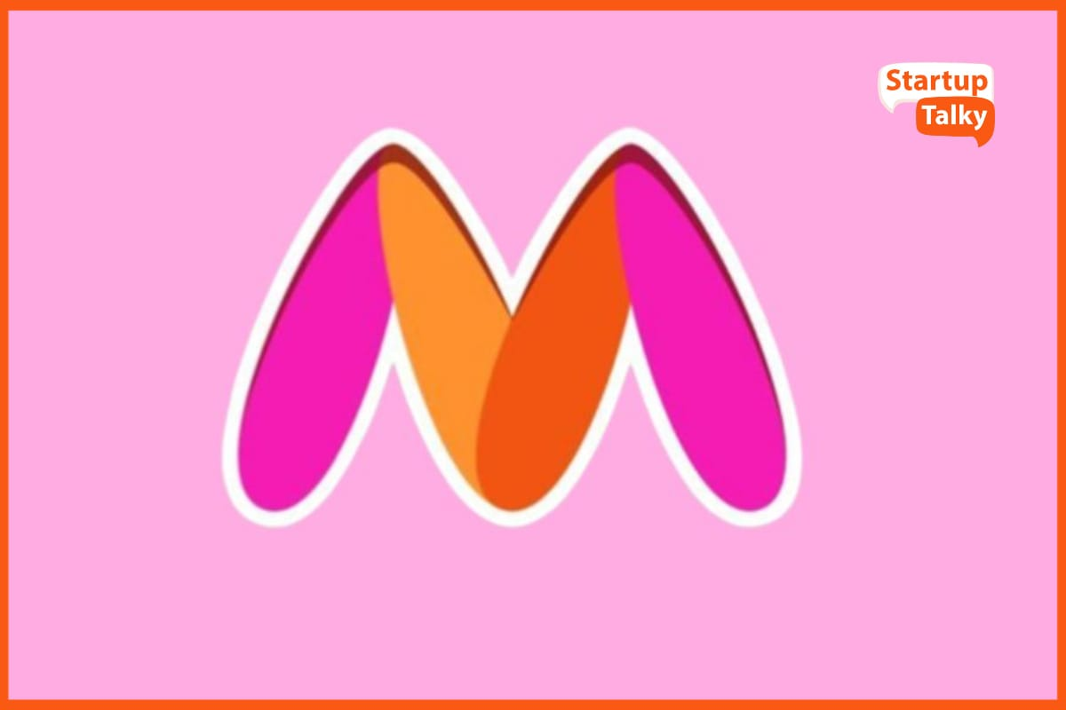



MYNTRA
ANALYSIS
S.Parimala gowri (MBE11)

Slide 2




OVERVIEW
INTRODUCTION TO MYNTRA.COM
Established by Mukesh Bansal along with Ashutosh Lawania and Vineet Saxena, Myntra sold on-demand personalized gift items. It mainly operated on the B2B (business-to-business) model during its initial years.
In 2011, Myntra began selling fashion and lifestyle products and moved away from personalization.
In 2014, Myntra was acquired by Flipkart in a deal valued at ₹2,000 crore (US$240 million).
MISSION: Use technology to democratize fashion & lifestyle and help people look good.

Slide 3

Setter
.
.
Trend
Myntra Business model:
E-commerce platform: offers over
PPMP: The Pure Play Marketplace model is fee-based, where sellers store and pack their products, and Myntra handles order fulfillment and returns.
MSA: The other business model is MSA.
Myntra also has a few other business models :
M-direct: A model that allows sellers to interact
with buyers directly.
JIT: also known as the PO model, involves
Myntra issuing a bulk purchase order
to sellers for multiple items
FBM: the Fulfillment by Myntra model
involves raising a stock transfer order to
the seller.

Slide 4


myntra Business model
B2C Triumph in Fashion E-commerce.
FBM: the Fulfillment by Myntra model involves raising a stock transfer order to the seller.
Myntra also uses an advanced inventory management model that includes real-time tracking, centralized fulfillment centers, and data-driven demand forecasting

Slide 5


Market position and growth
Myntra’s revenue for FY2022 was INR 2600 Crore, marking a significant growth compared to previous years ( Source: Business Today)
The platform boasts over 10 million active users monthly
(Source: Statista).
Myntra’s annual sale event, End of Reason Sale (EORS), saw a record participation of over 20 Million users in 2023 (Source: Economic Times)
Competes with giants like Etsy, Flipkart, Ajio, Meesho, Nykaa, Tata clique and Jiomart.com.
hold a significant share in India’s growing online E-commerce market.
First physical store in Bangalore to complement online presence.

Slide 6

From business standard,
Myntra has experienced rapid growth since the second half of 2023, with GMV growth almost doubling the online fashion market during the festive season. Monthly Active Users (MAU) increased by 33%, from 45 million in 2021 to 60 million by the end of 2023, contributing to this expansion.
Myntra's growth strategy focuses on increasing market share in non-apparel segments, driving premiumization in fashion, and expanding categories such as beauty, international, and D2C brands.

Slide 7


Myntra revenue model
Total operating Revenue (2021-2023): 43.75 billion INR
Marketplace services: In 2023, Myntra generated a gross revenue of
INR 17,812 million through marketplace services.
Logistics: The logistical services it offered brought in INR 19,915 million in 2023.
Advertisement: In 2023, Myntra generated a total revenue of INR 5,353 million through this approach.
With so many styles to choose from, it's hard to go wrong

Slide 8
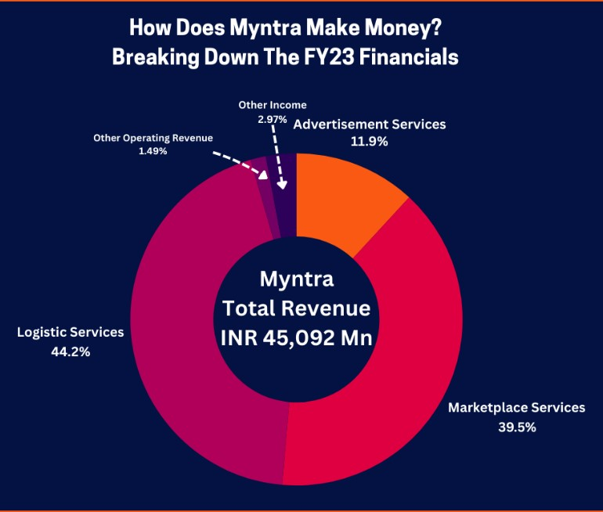
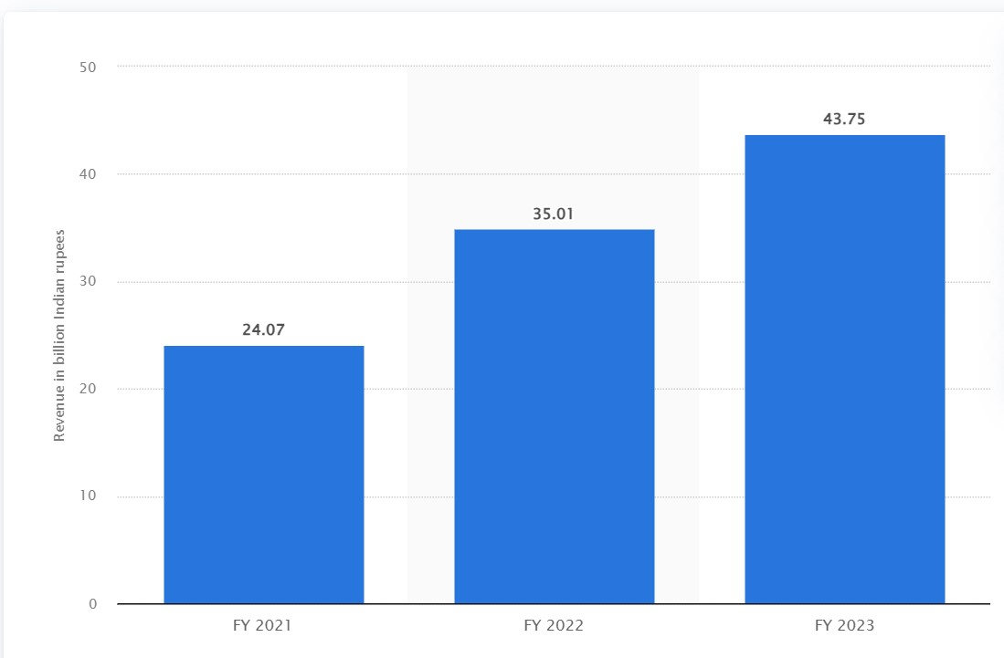
Myntra’s revenue model

Slide 9



Membership and market place revenue
Membership program: Myntra's Insider program offers members perks like coupons and offers, and privileges like exclusive access. Members can earn and redeem SuperCoins by participating in the program, visiting the Myntra Insider section, or redeeming SuperCoins for coupons and offers.
Marketplace model: Myntra is a marketplace that generates revenue by collecting commissions and service charges from brands and sellers on the platform.

Slide 10
Technology utilization
Docker cloud
Docker Cloud allows IT Ops team to deploy & manage Dockerized applications, from single container apps to distributed microservices stacks to any infrastructure.
Oracle PL/SQL
Oracle PL/SQL is a procedural language designed an extension to Structured Query Language (SQL).
Terraform
Terraform is a tool for building, changing, and versioning infrastructure safely and efficiently.

Slide 11
Technology utilization
Kubernetes
Kubernetes helps to manage a cluster of Linux containers as a single system to accelerate development and simplify operations.
YouTube
YouTube is a video-sharing service where users can watch, like, share, comment, and upload their videos. The video service can be accessed on PCs, laptops, tablets, and via mobile phones
Ansible
Ansible is open-source software that automates software provisioning, configuration management, and application deployment. Ansible connects via SSH, remote PowerShell, or other remote APIs.

Slide 12


Introduction to social media and review analysis

Slide 13

CUSTOMER review ANALYSIS USING TRUST PILOT, mouth shut and Google Play store WITH CHATGPT

Slide 14
CUSTOMER REVIEW ANALYSIS
Methodology:
Analyzed social media platforms ( Twitter, Instagram, and Facebook ) and review sites ( trust pilot, google reviews).
Categorized reviews into high-impact, medium-impact, and low-impact reviews
Findings based on Trustpilot review:
High impact: Serious issues involving fraud, lack of resolution, legal threats, or account blocking.
Medium impact: issues involving misleading pricing, poor customer support, delayed services, or poor product quality
Low impact: Frustration due to minor issues like delays or unmet expectations, but no extreme escalation.

Slide 15
Customer Review analysis
Findings based on Mouth shut reviews:
High impact: The reviews are highly critical and indicate serious issues with the company’s service, potentially leading to a significant loss of customer trust. They reflect a pattern of dissatisfaction that could influence new customers' decisions strongly.
Medium impact: The reviews highlight specific grievances that indicate a need for improvement, particularly in customer support and delivery issues. While they could deter some customers, they also leave room for potential recovery through better service.
Low impact: The reviews reflect isolated issues, typically related to returns or product quality, but do not imply a systemic failure. They suggest that while improvements are needed, the service can still be satisfactory for some users.

Slide 16
Customer Review analysis
Findings based on Google Play Store reviews:
High impact: Reviews that express strong dissatisfaction or severe issues affecting overall experience and credibility.
Medium impact: Reviews that express strong dissatisfaction or severe issues affecting overall experience and credibility.
Low impact: Reviews with either mixed experiences or lower severity, often overshadowed by more impactful reviews

Slide 17
High-impact consumer comments:
Issues with size and return policies; extensive complaints about customer service.
Received wrong and old products, feels like "black magic." No resolution from Myntra.
Non-returnable/exchangeable high-value item; denied refund or exchange.
Detailed complaint about wrong product delivery and lack of accountability; feels cheated.
Disappointment with delayed deliveries, unhelpful customer support, and navigation issues. Recommends stopping use until improvements are made

Slide 18
Mediium-impact consumer comments:
Fake discounts, and misrepresentation of product pricing.
Damaged product, slow return, and refund process.
Orders cancelled due to technical issues during discount offers.
Frustration with the non-delivery of products despite payment.
Wrong product delivery and lack of exchange; expresses disappointment in the brand’s handling of issues
Items disappearing from cart without user action. Expresses wariness about future use.

Slide 19
low-impact consumer comments:
Good shopping app but needs work on the return policy (generally positive but mentions delays).
Mixed review; decent returns but quality is questionable for some products.
Criticism of customer support and product quality, but with fewer helpful votes.
Positive but mentions occasional high prices.
Highly positive review about user experience but is less relevant now.
Long delivery times (15+ days) for a T-shirt, no customer care communication.

Slide 20
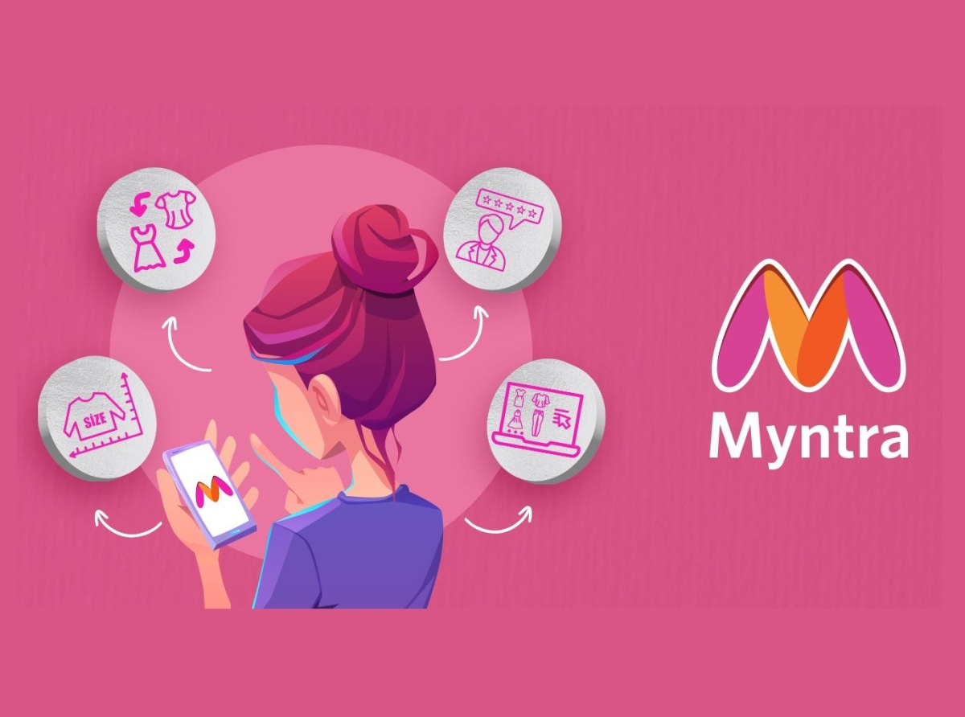
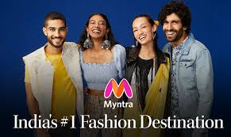
Brand perception analysis using reviews on Trust Pilot, mouth shut and Google Play Store

Slide 21
Brand perception analysis
POSITIVE ASPECTS:
Product Variety:
Some customers appreciate Myntra's diverse collection, especially in categories like kurtas, tops, and suits, indicating that the platform offers unique items often unavailable elsewhere.
Discounts and Offers:
A few users noted that Myntra provides discounts, which can attract budget-conscious consumers looking for deals on fashion items.

Slide 22
Brand perception analysis
NEGATIVE ASPECTS:
Customer Service Issues:
A significant number of reviews highlight a severe lack of customer support. Complaints often mention unresponsive representatives, inadequate handling of return requests, and a general disregard for customer concerns.
Return Policy Complaints:
Many customers express frustration with the return process. Issues include:
Wrong Products Delivered: Several reviews mention receiving incorrect items, which complicates, initiating returns.
Delay in Return Pickups: Many customers report long waits for return pickups, with some experiencing failed attempts altogether.
Refund Problems: Customers often complain about not receiving refunds or receiving incorrect amounts, causing financial dissatisfaction.

Slide 23
Brand perception analysis
Conclusion:
The negative sentiment reflected in customer reviews indicates a pressing need for Myntra to reevaluate its service model. By addressing these concerns and implementing recommended improvements, Myntra can work towards rebuilding customer trust and enhancing overall brand perception.

Slide 24
Customer sentiment analysis BASED ON GOOGLE PLAY STORE REVIEWS AND RESPONSES

Slide 25
Customer sentiment analysis
Overall sentiment:
Negative Sentiment: The majority of the reviews reflect dissatisfaction with Myntra's services, particularly focusing on customer support and technical issues.
Positive Sentiment: A minority of reviews highlight positive experiences, primarily focusing on product variety and user interface.

Slide 26
Customer sentiment analysis
Key Themes identified:
Customer Service Issues:
Negative Feedback: Multiple reviews mention unresponsive customer service and unsatisfactory resolutions to complaints. Users reported difficulties with return processes, including cancellations without explanation and long waiting periods for pickups.
Example Review: "Myntra has deactivated my account stating that there is a violation of terms...their customer service is the worst."
Technical Glitches:
Negative Feedback: Many users experienced technical difficulties, including app crashes, issues with order placements, and problems during returns/exchanges.
Example Review: "The app stalls when I try a style exchange, making it impossible to complete the process."

Slide 27
Key Themes identified:
3. Pricing and Coupons:
Negative Feedback: Users expressed frustration over fluctuating prices, invalid coupon codes, and hidden charges. Some felt misled by discount advertisements that didn't apply to their purchases.
Example Review: "The price of the items keeps changing every 5 minutes... seems like you are playing with me."
4. Product Quality and Fulfillment:
Negative Feedback: Several customers received wrong or defective products and encountered issues with returns for items that did not meet expectations.
Example Review: "I received the wrong product... I've to go through the hassle of picking up parcels, returning them..."
5. Positive Experiences:
Positive Feedback: A few users praised Myntra for its wide range of products and a generally user-friendly interface. Some reviews highlighted quick delivery and quality products.
Example Review: "The user interface is smooth and easy to navigate, with a vast collection of brands and styles."

Slide 28
Customer sentiment analysis
Summary of Customer Sentiment:
Positive Reviews: 23%
Negative Reviews: 77%
Helpful Feedback Count: High engagement with reviews that discuss negative experiences, indicating a strong community response to dissatisfaction

Slide 29
CURRENT MARKET TRENDS
In fashion, hoodies under blazers, women’s oversized bomber jackets, cropped cardigans, casual trench, boiler suit, fantasy florals, Puff sleeves, colour blocking, monochrome matrix, maxies.
Global Fashion Influencer Marketing Market size was valued at USD 3.7 billion in 2022 and is poised to grow from USD 5.03 billion in 2023 to USD 58.50 billion by 2031, growing at a CAGR of 35.9% in the forecast period (2024-2031).
Current trending influencer contents are video content, live streaming, interactive content, nano influencer, deeper partnerships, influencers as entrepreneurs, diversity, inclusivity, authenticity and relatability.

Slide 30
Myntra competitors in August 2024
Etsy.com with 406.25M visits,99 authority score, 46.14% bounce rate.
Ajio.com, with 21.45M visits, 79 authority score, 55.96% bounce rate
Meesho.com, with 30.45M visits, 75 authority score, 50.96% bounce rate
Tatacliq.com, with 7.78M visits, 64 authority score, 63.96% bounce rate
Nykaa.com, with 12.06M visits, 75 authority score, 59.44% bounce rate
Flipkart.com, with 217.72M visits, 97 authority score, 51.98% bounce rate
Jiomart.com, with 12.81M visits, 73 authority score, 52.21% bounce rate

Slide 31

Competitive analysis of myntra
Competitors: Etsy, Flipkart, Meesho, Ajio, Nykaa, Bewakoof
Comparison factors:
Product range and quality
Pricing strategies
Customer service satisfaction
Social media presence and Engagement
Good logistics support
Competitive advantage
Focus on niche clothing segments and personalized customer interactions

Slide 32
STRATEGIC RECOMMENDATIONS
Enhance Customer Service Training: Invest in better training for customer service representatives to ensure accurate information and efficient handling of complaints.
Streamline Returns and Refunds: Simplify the return process and provide clearer guidelines for customers. Consider automating some aspects to expedite refunds.
Improve Quality Control: Implement stricter quality checks to ensure products meet customer expectations before shipment.
Increase Transparency: Communicate the terms of discounts and offers to avoid misleading customers. Provide real-time updates regarding order statuses.
Address Delivery Issues: Collaborate more closely with delivery partners to ensure timely and accurate deliveries, and improve accountability in case of discrepancies.

Slide 33
Strategic recommendations
Improve App Functionality: Focus on resolving technical glitches and enhancing the user interface to restore user confidence and ease of use.
Clarify Pricing Policies: Ensure transparency regarding pricing, discounts, and coupon applicability to reduce customer frustrations.
Improve marketing strategy: Focus on bringing good customer reviews
Introduce loyalty programs: higher retention rates, reduced churns, and bring competitive advantage to the industry.

Slide 34


Website used for analysis
Finding market trends in content marketing strategy:
https://www.grandviewresearch.com/industry-analysis/fashion-influencer-marketing-market#:~:text=The%20global%20fashion%20influencer%20marketing,are%20adopting%20influencer%20marketing%20strategies.
Finding current market trends in fashion:
https://www.fibre2fashion.com/industry-article/9076/36-best-current-fashion-trends

Slide 35


Website used for analysis
Finding detailed rankings and competitors and web traffic using the website:
https://www.semrush.com/website/myntra.com/competitors/
For detailed competitor analysis:
https://www.similarweb.com/website/myntra.com/competitors/

Slide 36



Thank you

